Slide 1
Optimization Under fairness constraints
Jing Gong

Slide 2
Main Contribution
A Causal Approach in Decision Making Process
Apply causal effect measures as constraints in optimal decision making
Discrete domain optimization
Continuous domain optimization in linear causal models
Classification and regression improvement

Slide 3
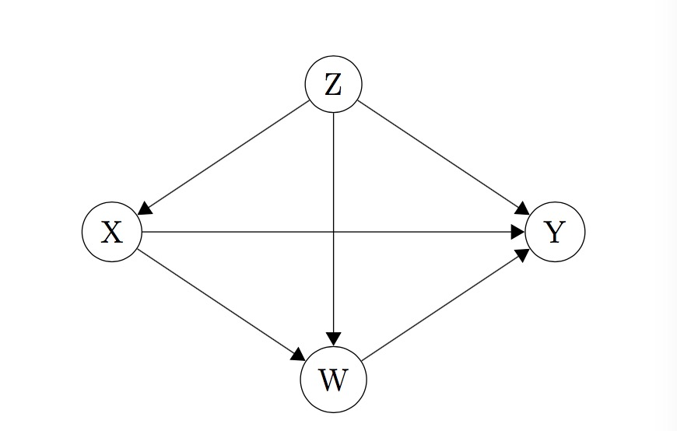
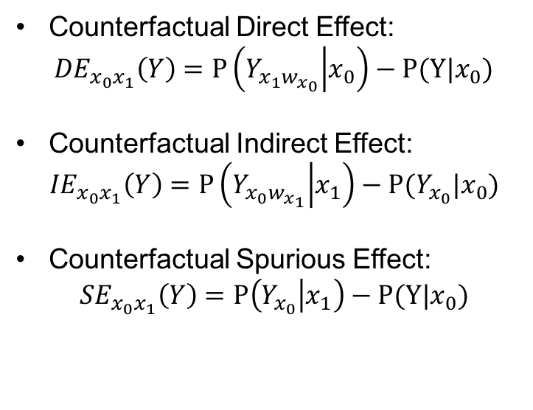
Fairness Measures and Causal Model
Causal Discrimination Measures
Counterfactual Direct Effect:
${DE}_{x_{0}x_{1}}\left(Y\right)=P\left(Y_{x_{1}w_{x_{0}}} | x_{0}\right)−P(Y|x_{0})$
Counterfactual Indirect Effect:
$${IE}_{x_{0}x_{1}}\left(Y\right)=P\left(Y_{x_{0}w_{x_{1}}} | x_{1}\right)−P(Y_{x_{0}}|x_{0})$$
Counterfactual Spurious Effect:
$${SE}_{x_{0}x_{1}}\left(Y\right)=P\left(Y_{x_{0}} | x_{1}\right)−P(Y|x_{0})$$
X: Sensitive attribute
Y: Objective action
Z: Observed confounder
W: Mediator

Slide 4
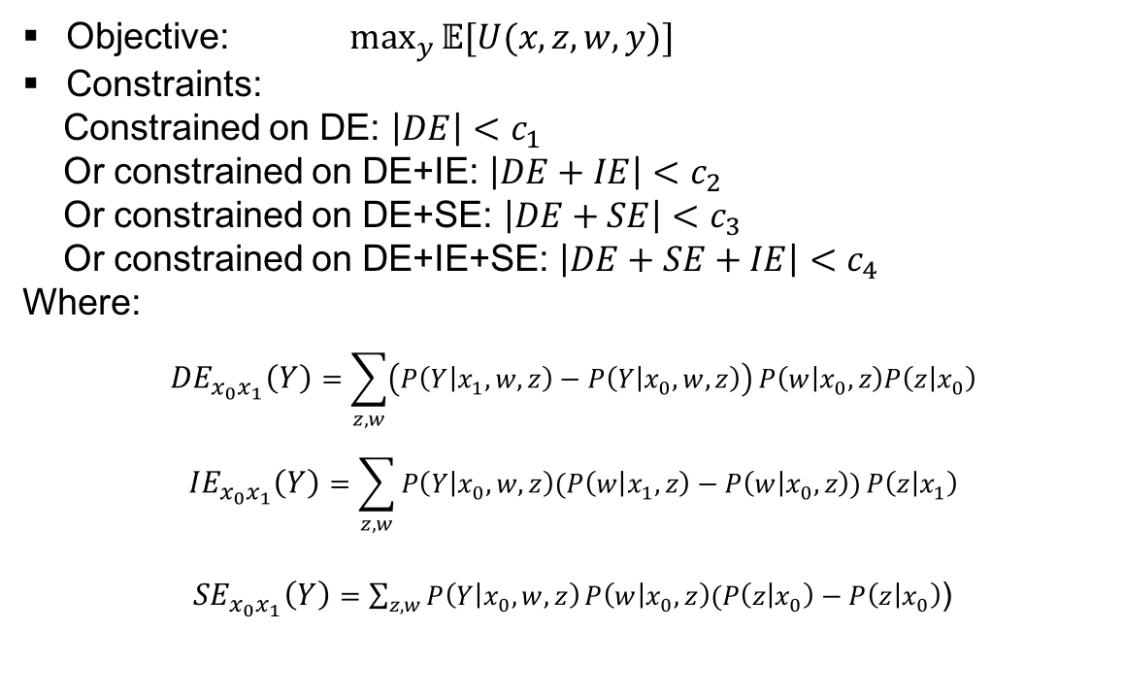
Optimization Under Binary Domain
Maximize Expected Utility under Fairness Constraints
Objective: $\max_{y}{𝔼[U(x,z,w,y)]}$
Constraints:
Constrained on DE: $\left|DE\right|<c_{1}$
Or constrained on DE+IE: $\left|DE+IE\right|<c_{2}$
Or constrained on DE+SE: $\left|DE+SE\right|<c_{3}$
Or constrained on DE+IE+SE: $\left|DE+SE+IE\right|<c_{4}$
Where:
$${DE}_{x_{0}x_{1}}\left(Y\right)=\sum_{z,w}{\left(P\left(Y | x_{1},w,z\right)−P\left(Y | x_{0},w,z\right)\right)}P\left(w | x_{0},z\right)P\left(z | x_{0}\right)$$
$${IE}_{x_{0}x_{1}}\left(Y\right)=\sum_{z,w}{P\left(Y | x_{0},w,z\right)(P\left(w | x_{1},z\right)−P\left(w | x_{0},z\right))}P\left(z | x_{1}\right)$$
${SE}_{x_{0}x_{1}}\left(Y\right)=\sum_{z,w}{P\left(Y | x_{0},w,z\right)}P\left(w | x_{0},z\right)(P\left(z | x_{0}\right)−P\left(z | x_{0}\right)$)

Slide 5
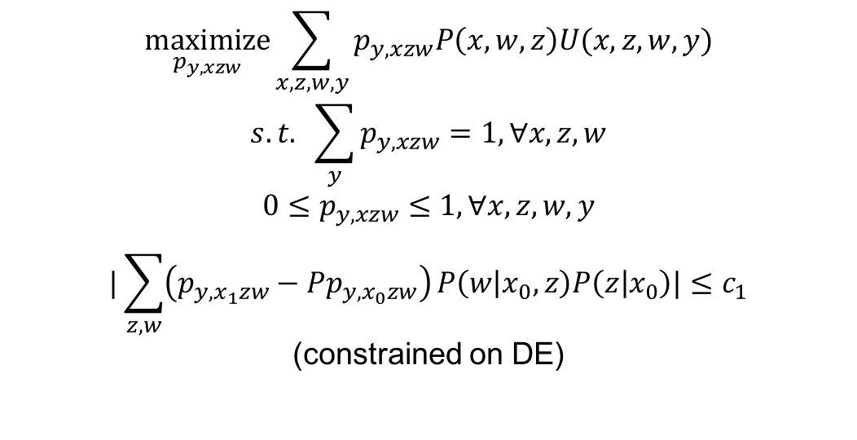
Optimization Under Binary Domain
A Linear Program Formulation
$$\underset{p_{y,xzw}}{maximize}{\sum_{x,z,w,y}{p_{y,xzw}P\left(x,w,z\right)U(x,z,w,y)}}$$
$$s.t. \sum_{y}{p_{y,xzw}=1, ∀x,z,w}$$
$$0≤p_{y,xzw}≤1, ∀x,z,w,y$$
$$|\sum_{z,w}{\left(p_{y,x_{1}zw}−Pp_{y,x_{0}zw}\right)}P\left(w | x_{0},z\right)P\left(z | x_{0}\right)|≤c_{1}$$
(constrained on DE)

Slide 6
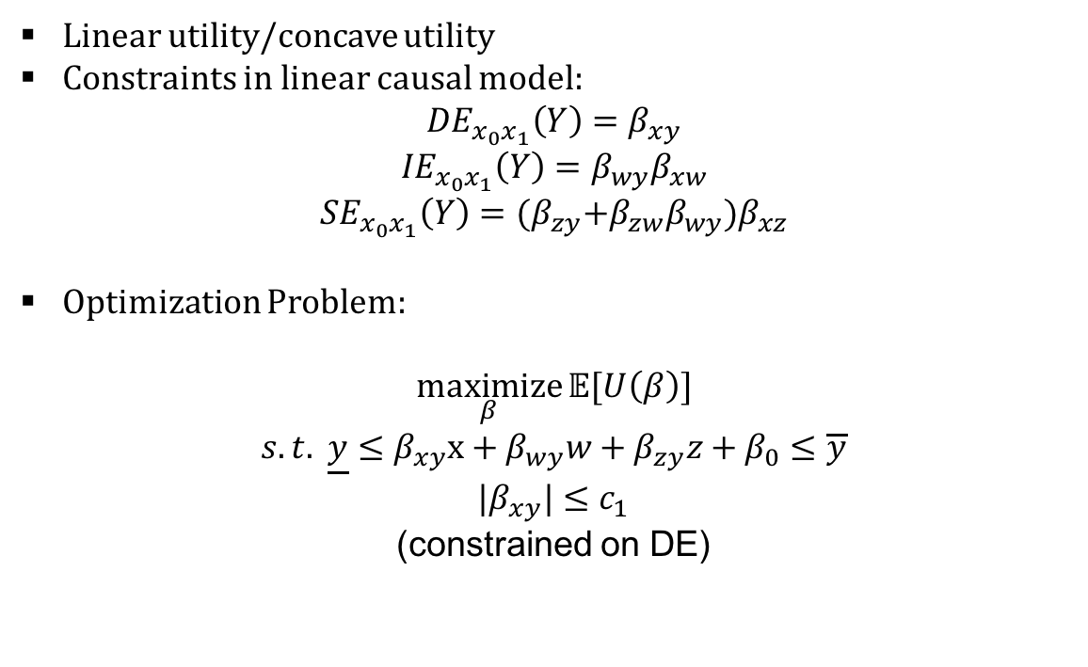
Optimization Under Linear Causal Model
A Convex Optimization Formulation
Linear utility/concave utility
Constraints in linear causal model:
$${DE}_{x_{0}x_{1}}\left(Y\right)=β_{xy}$$
$${IE}_{x_{0}x_{1}}\left(Y\right)=β_{wy}β_{xw}$$
$${SE}_{x_{0}x_{1}}\left(Y\right)={(β}_{zy}+β_{zw}β_{wy})β_{xz}$$
Optimization Problem:
$$\underset{β}{maximize}{𝔼[U\left(β\right)]}$$
$$s.t. \underline{y}≤β_{xy}x+β_{wy}w+β_{zy}z+β_{0}≤\overline{y}$$
$$|β_{xy}|≤c_{1}$$
(constrained on DE)

Slide 7
Optimization Under Linear Causal Model
Nonconcave Utility
Linear inequality constraints: Continuous and monotone
Monotonic utility:
Constraints are tight when utility function has different monotonicity from the linear constraints(Suppose all coefficients are bounded)
Global optimal in a normal set: increasing utility subject to an increasing constraint with nonnegative coordinates.(Rubinov et al.)
Generic Utility:
Linearly constrained Lagrangian Methods(differentiable utility): Might not converge! Local optimal
Genetic algorithm(global optimal): Good sometimes(might not efficient!)

Slide 8
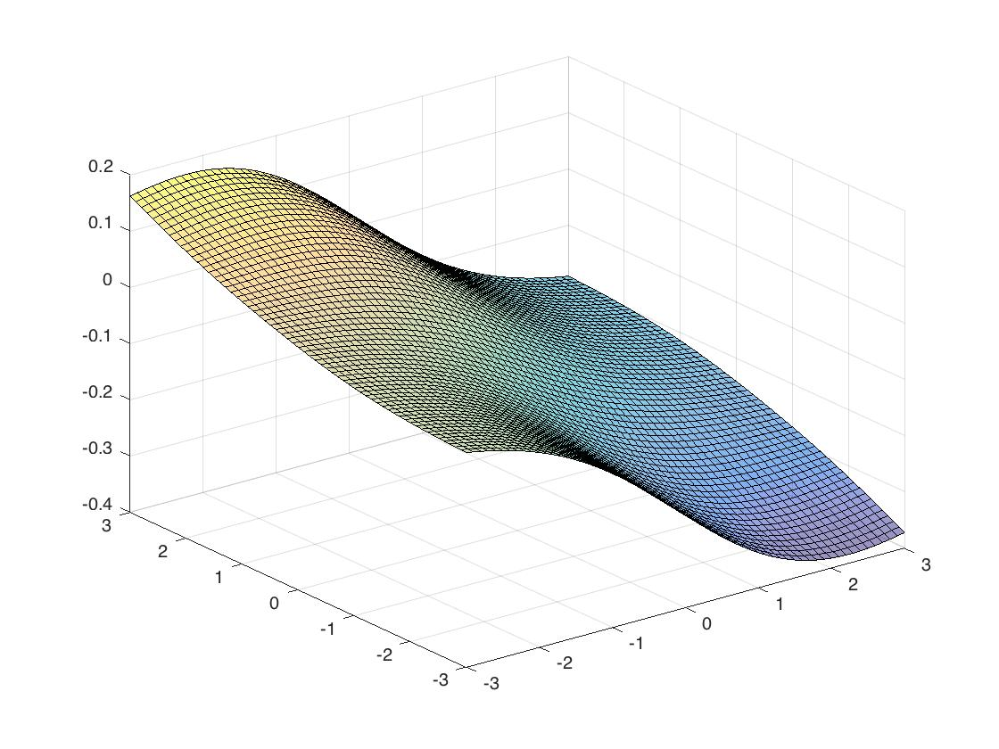

Optimization Under Classification
Logistic Regression
Convex objective function:
$$\underset{β}{maximize}{\sum_{i=1}^{n}{y_{i}β^{T}x−log⁡(1+e^{β^{Tx}})}}$$
Nonlinear constraints:
Consider IE: $|\frac{k_{1}}{1+e^{−β_{w}−β_{z}}}+\frac{k_{2}}{1+e^{−β_{w}}}+\frac{k_{3}}{1+e^{−β_{z}}}+\frac{k_{4}}{2}|≤c_{2}$

Slide 9
Optimization Under Classification
Logistic Regression
Genetic algorithm: find global optimal
Constrained on DE:
 | DE | Zero one loss
unconstrained | 0.25 | 0.2
Constrained(c2=0.01) | 0.0090 | 0.43

Slide 10
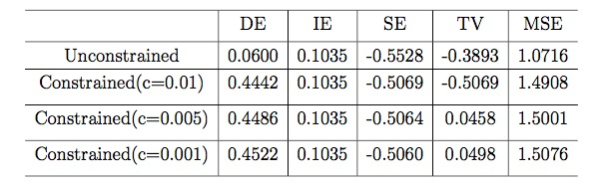

Optimization Under Regression
Linear Regression
Convex optimization:
$$\underset{β}{minimize}{\sum_{i=1}^{n}{{(y_{i}^{}−x_{i}^{T}β)}^{2}}}$$
$$s.t. |β_{xy}k_{x}+β_{wy}k_{w}+β_{zy}k_{z}|≤c$$
(constrained on total variation)
Lagrange function:
$L\left(β,λ\right)=$ $\sum_{i=1}^{n}{{(y_{i}^{}−x_{i}^{T}β)}^{2}}+λ_{1}\left(k_{}^{T}β−c\right)+λ_{2}\left({−k}_{}^{T}β+c\right)$
Experiments:

Slide 11
Conclusion and Future Goal
Conclusion
Applying causal measures as fairness constraints can balance decision making in binary cases and linear causal models
Perform fair predictions in machine learning algorithms
High dimensional states: Optimization may not be efficient.
Non-linear causal models: constraints may be complicated.
Utility function may not have explicit expression
Future Goal

Slide 12
Reference
[1] J. Zhang, E. Bareinboim. Fairness in Decision-Making – The Causal Explanation For- mula. AAAI-18. In Proceedings of the 32nd AAAI Conference on Artificial Intelligence, 2018, forthcoming. Purdue AI Lab, Technical Report (R-30), Nov, 2017. [2] S. C. Davies, E. Pierson, A. Feller. Algorithmic Decision Making and the Cost of Fairness, 2017
[3] M. B. Zafar, I. Valera, M. G. Rodriguez, K. P. Gummadi. Fairness Constraints: Mechanisms for Fair Classification, 2017 [4] M. Hardt, E. Price, N. Srebro. Equality of Opportunity in Supervised Learning, 2016 [5] P. Hansen, B. Jaumard, S. H. Lu. Some Further Results on Monotonicity in Globally Optimal Design, 1989.
[6] Alexander. Rubinov , Hoang. Tuy & Heather. Mays (2001) An alogrithm for monotonic global optimization problems , Optimization, 49:3, 205-221, DOI: 10.1080/02331930108844530

Slide 13
Thank You

